Slide 1

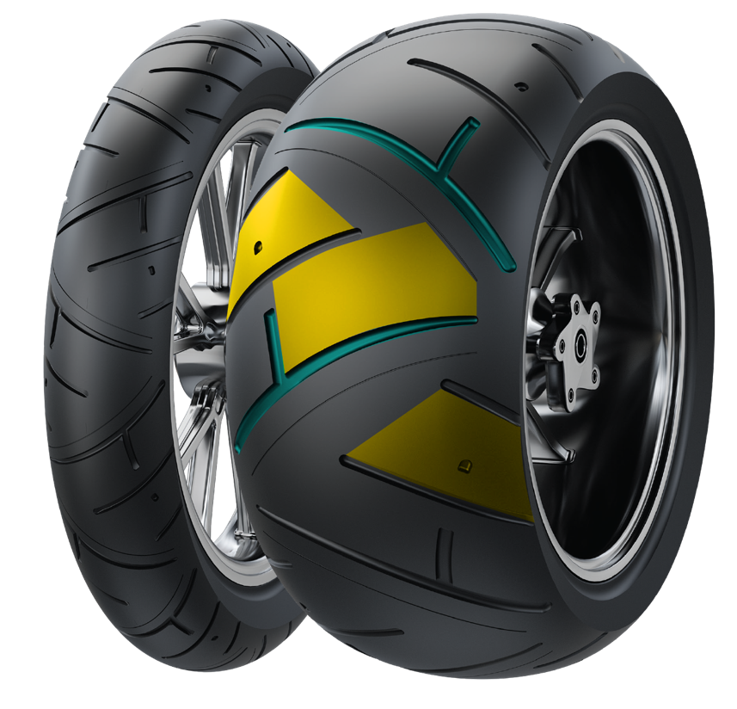
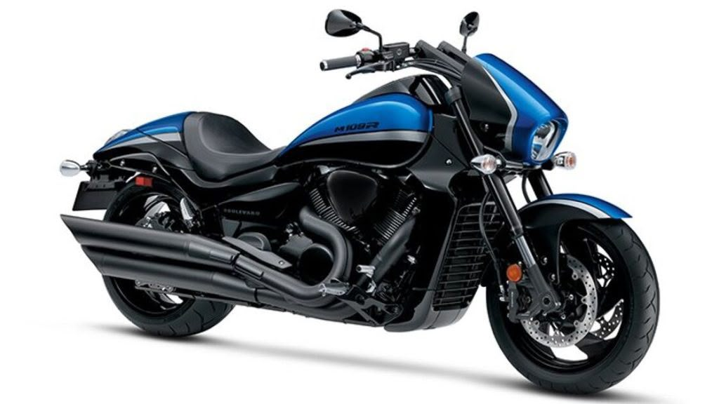
ADRENO CM-T3
CRUISER
CM-T3 FEATURES
Steel wire radial structure​​:
High-speed stability and
comfortable riding experience
Wide block tread design​​:
Excellent straight-line stability for long distance touring
LFC700
CM-T3 SIZES
Reinforced Carcass
Construction: Designed for
heavy-duty cruiser-style bikes
300/35R18 87V
Long-pitch main groove design​​: Enhanced driving performance and water dispersion

