Slide 1

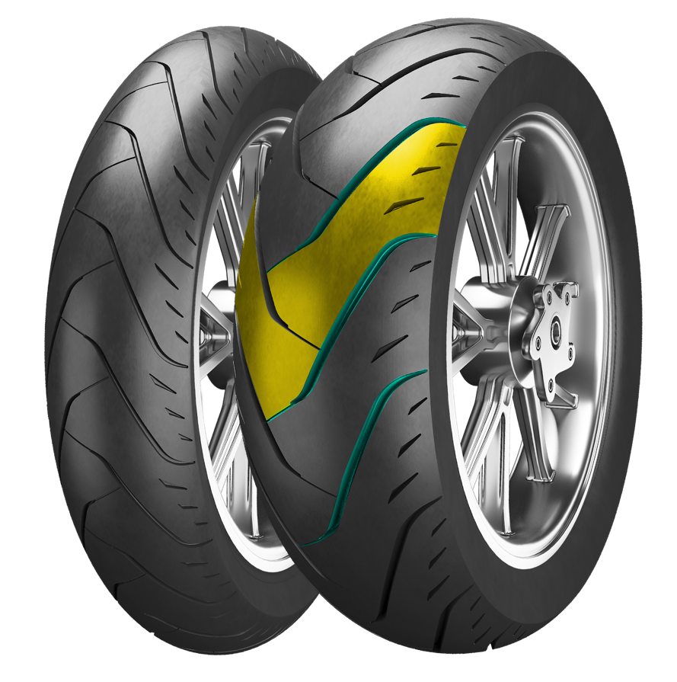
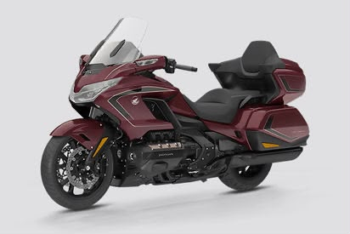

ADRENO CM-T1
CRUISER
CM-T1 FEATURES
Honda gold wing
Radial structure​​ enhances the rigidity of the whole tire, providing a higher loading index more suitable for cruising
S2000
High land ratio provides superior grip
CM-T1 SIZES
130/70R18 63H
Streamlined groove design delivers greater water evacuation
180/60R16 74H

