Slide 1

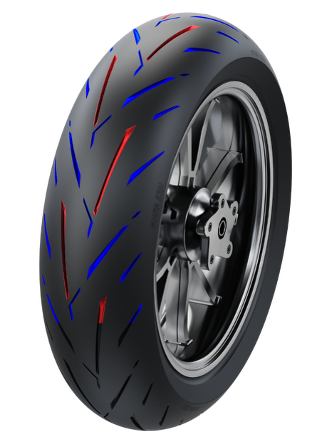
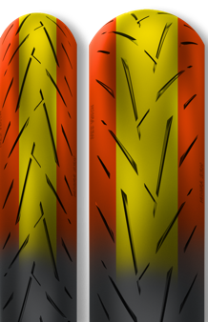
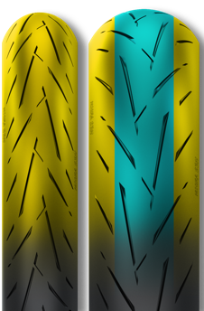
RIDE MIGRA CM-S3N+ / CM-S3N
Streamlined grooves enhance the ability to break water film on slippery roads
CM-S3N PLUS
Lateral grooves enhance drainage performance, improving handling and safety on slippery roads
Front: 120/70ZR17 58W
Rear: 180/55ZR17 73W
Non-Joint Belt Technology
Reduces the number of joints, enhances tire uniformity, optimises contact pressure distribution and improves steering precision & driving control.
CM-S3N
Front: 110/7017 54H
Front: 120/70ZR17 58W
Rear: 140/70R17 66H
Rear: 150/60R17 66H
Rear: 160/60ZR17 69W
Rear: 180/55ZR17 73W
Rear: 190/55ZR17 75W
Rear: 200/55ZR17 78W
Three-Area Compound Technology
CM-S3N PLUS
CM-S3N
Sport Compound on the central tread for enhanced control while retaining high-speed stability and prolonged tread life
Track Compound on the tire’s edges for maximising cornering grip
Road Compound on the central tread maximises high speed stability and tread life
Sport Compound
on the tire’s edges enhances cornering grip while leaning

Slide 2
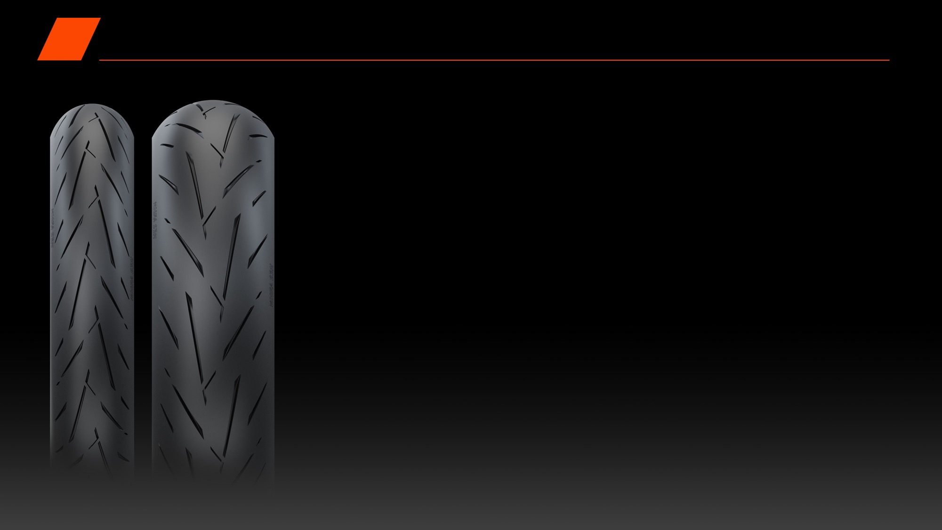
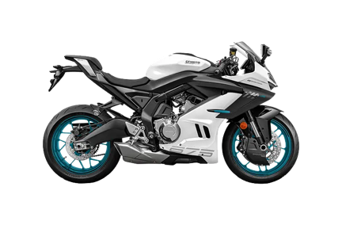
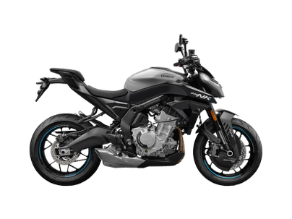
RIDE MIGRA CM-S3N+ / CM-S3N OEM
CM-S3N+
675SR-R
675NK
CM-S3N
CBR500R Four
CB500 Super Four
500SR Voom
600SRK RS
703R
RR660S

